Slide 1
Trailblazer

Slide 2
Food Tourism Platform
Food Tourism and Related Products E.g.: All in one place for Guided Tours, Wine Tours, Casual Food Tours, Formal Food Tours, Culinary Classes, Street Food Tours, Food Trucks.
Lacks a dominant player and is currently siloed.
Proposing a Simple but an Intelligent Platform.
Gain sentiments from feedback and improve loyalty.
Value added services. E.g.: Rearrange products on the fly, Recommendation Engine, Data Insights, Proactive Services, Integrate with CRM, Real time customer support, loyalty rewards.

Slide 3
Architecture
Social/Web
JS Framework
Server
REST API
Sentiment Analysis
JS Framework
API Callback
UI (Desktop, Tablet, Mobile)
Web socket
NoSql DB
Food Tourism Products
REST API
Value Added Service

Slide 4
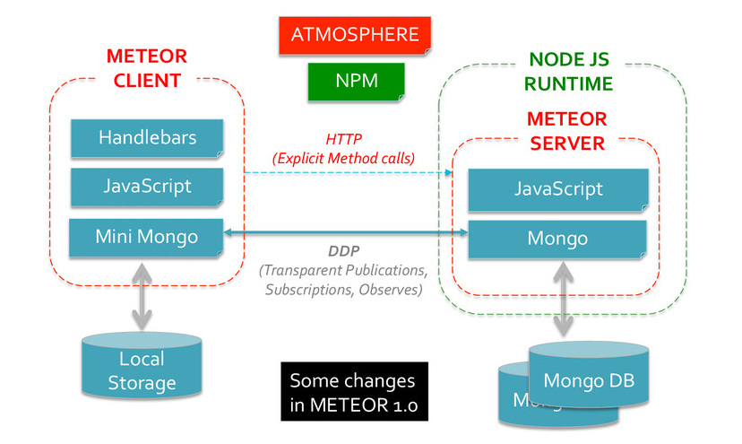
Full stack Java script FW
Fast and Easy Full Stack JS FW for Web App & Mobile App + Lightweight = Meteor JS or similar
https://www.mongodb.com/blog/post/meteor-build-ios-and-android-apps-are-delight-use

Slide 5
Sentiment Analysis
Feedback
Collect
Social
Sentiment Analysis
Over time
Geographic area
Customer
Recommendation
Improve Product
Proactive Service
Marketing
Offers
Loyalty
Rearrange campaign
Sentiment Analysis
Improve
2. Targeted Offers
3. Integrate CRM
4. Attract
5. Incentives
6. Loyalty
API, Database, Crawl, Scrape
Documents
Process
Data
NLP, Extract Sentiment

Slide 6
Value Added Service
Bookings.
Real time data insights.
Real time customer support for the duration of service.
Recommendation Engine.
Rearrange products on the fly based on feedback or sentiments.
Loyalty for using the platform, products, referrals and providing feedback.

Slide 7
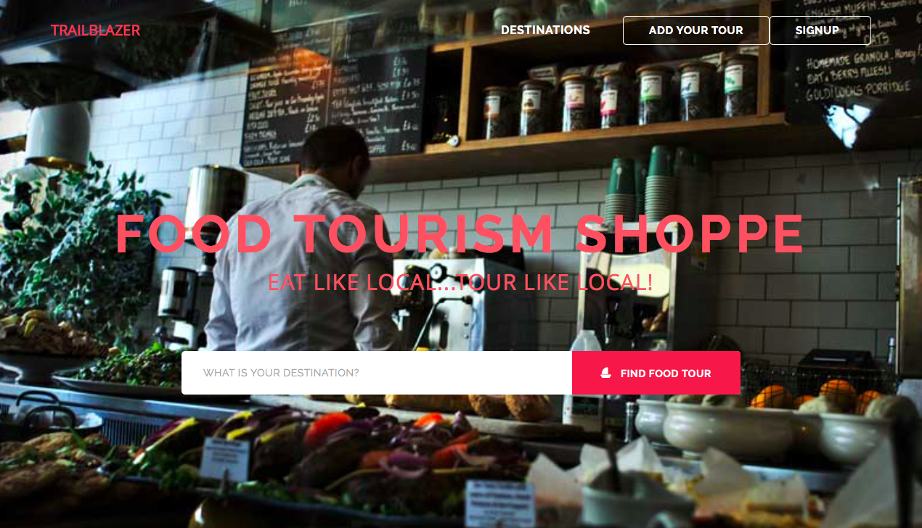

Slide 8
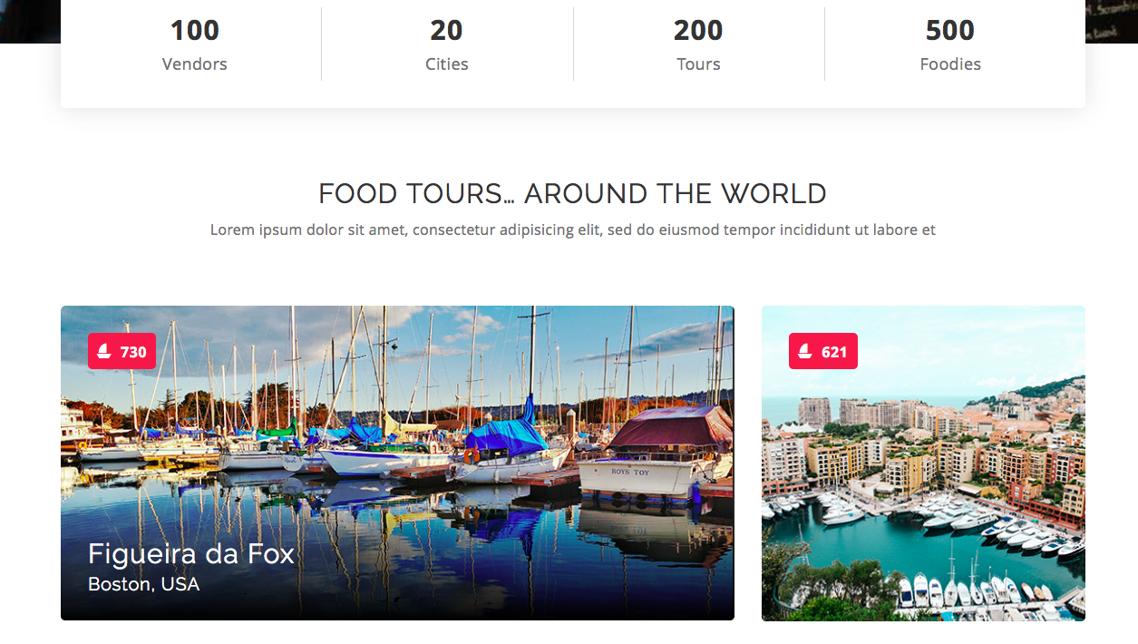

Slide 9
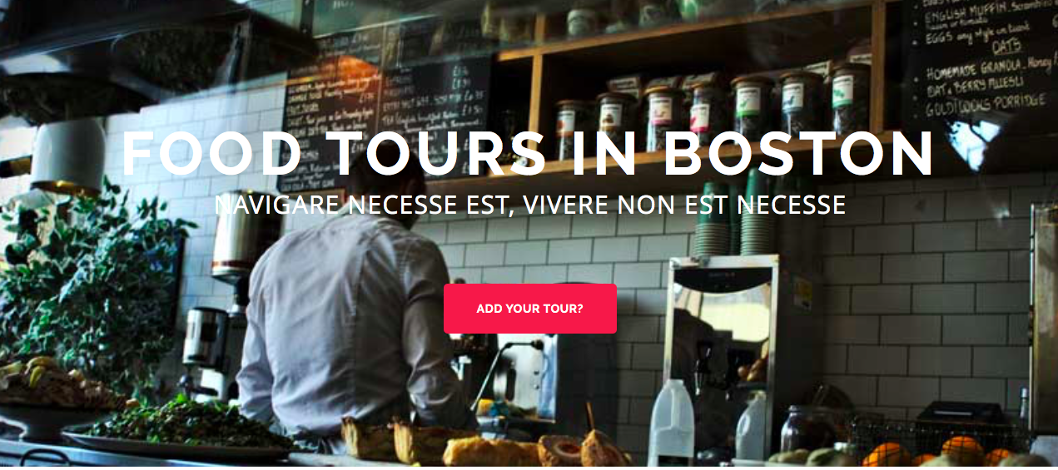

Slide 10
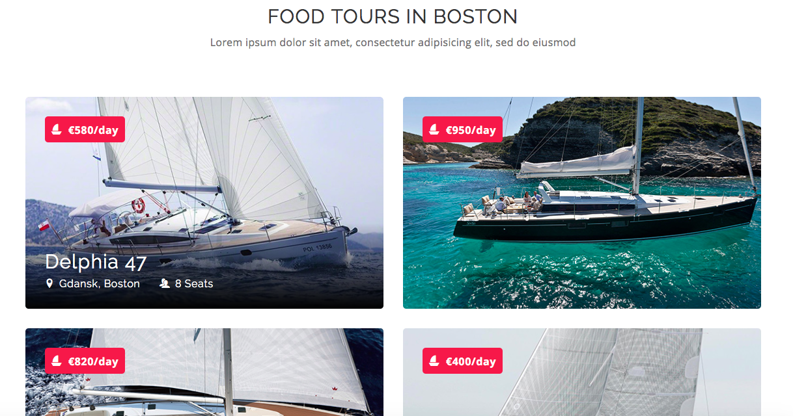

Slide 11
Milestones
Sort out requirements – 1 month
Complete a prototype – 3 months
- Sign up
- Add your products – basic form
- View all products on the main page
- Provide feedback via comments on each products
- Sentiment analysis of the product
Get suggestions on the proto – 1 month
Minimum Viable Product – 3 months
Value Added Features

